Slide 1
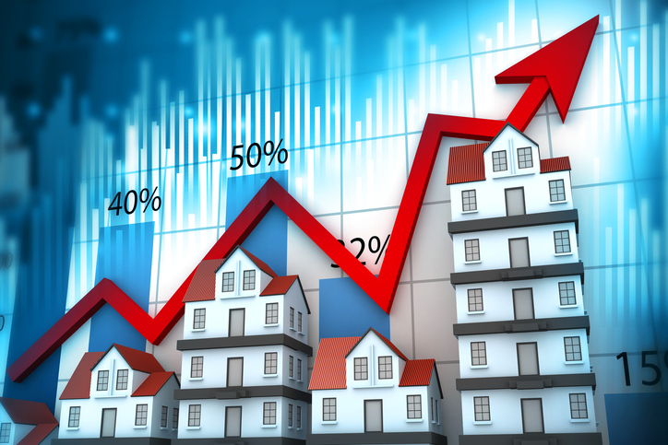

Machine Learning Model for Predicting House Prices
By:
Preyesh Patel

Slide 2

Contents
Introduction
Problem Statement
Initial Data Exploration
Exploratory Data Analysis - Visualizations
Data Preprocessing
Feature Engineering
Model Selection
Training the Model
Model Evaluation
Fine-Tuning the Model
Conclusion

Slide 3

Introduction
Determining the right price of a house involves carefully considering various factors related to the house.
This helps meet the expectations of both buyers and sellers by ensuring an accurate valuation based on market trends and the property's attractiveness. .
Fair and transparent pricing encourages healthy competition and helps consumers make decisions that match their budgets and personal preferences.

Slide 4
Problem Statement
In the dynamic real estate market, the ability to predict house prices accurately has become more significant.
These predictions empower homeowners, buyers, and real estate professionals by offering insights into property values, which support informed decision-making.
Solution/Objective of this project: To develop a predictive model capable of estimating house prices using various relevant features.

Slide 5
Initial Data Exploration
We load the dataset into a suitable data structure using pandas. Dimension of the Datasets = 1460 *81
There is a total of 1460 records/rows and 81 attributes/columns.
Out of 81 columns, 38 columns are numerical, and 43 columns are categorical.
Performed Descriptive Statistical Analysis on Numerical Features
Numerical Features like: “LotArea,” “BsmtFinSF1”, ”BsmtUnfSF,” “TotalBsmtSF”, ”GrLivArea’, “MiscVal,” and even the target feature SalePrice is having very high deviation values that can lead to bias, Overfitting, and can affect the accuracy of the model.

Slide 6
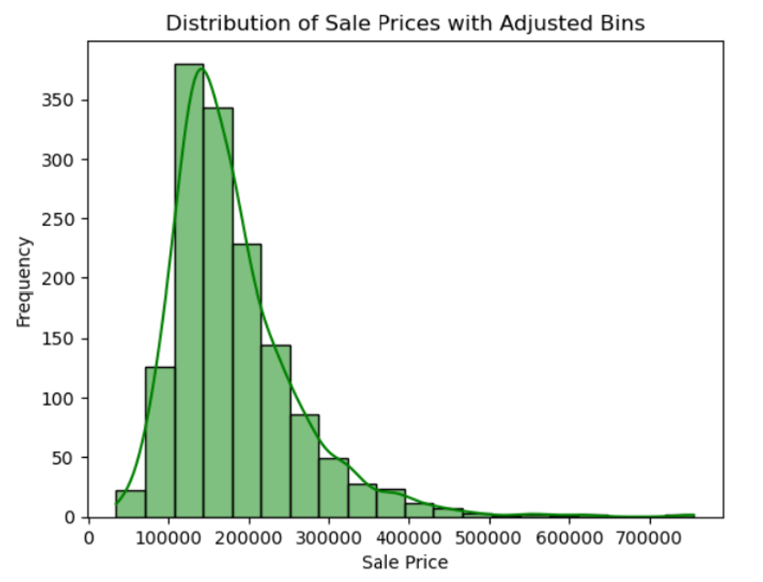
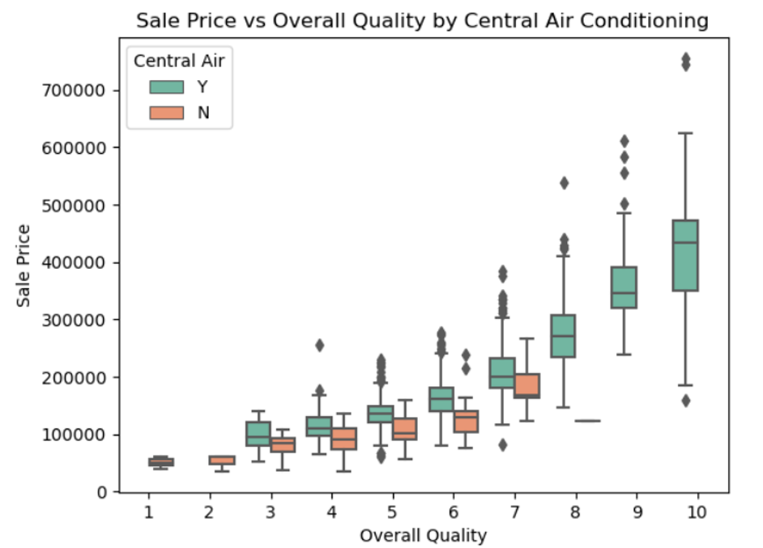
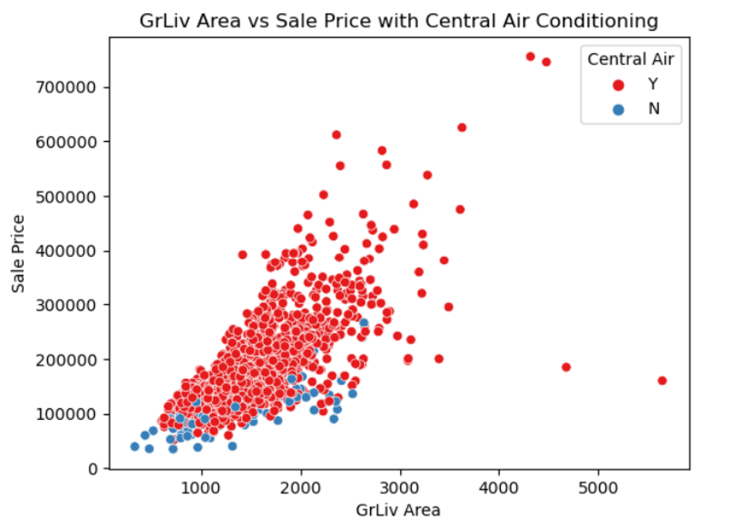
Exploratory Data Analysis
To identify trends, patterns, and relationships among the variables we plotted the following graphs.

Slide 7
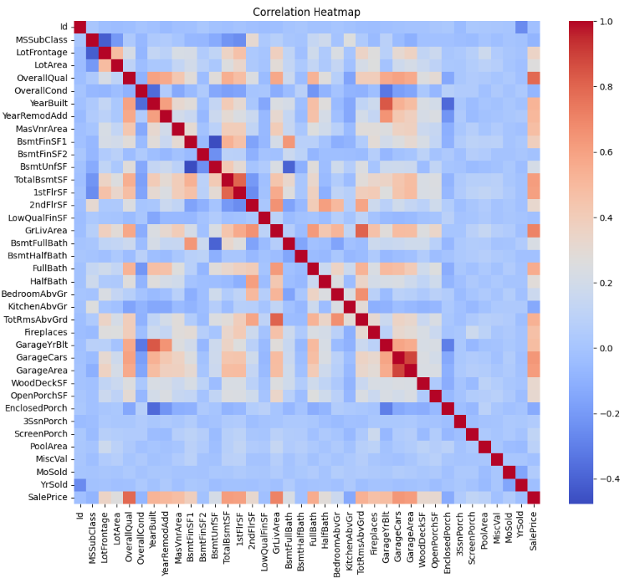
Exploratory Data Analysis

Slide 8
Exploratory Data Analysis – Key Findings
Price Distribution Insight: The histogram shows that most house prices are clustered within a specific range, highlighting potential outliers or extreme values.
Quality Impact: The box plot reveals that higher overall quality ratings correlate with higher home prices and that homes with central air conditioning tend to have higher prices at similar quality levels.
Area vs. Price Relationship: The scatter plot can indicate whether larger homes (in terms of living area) tend to fetch higher prices and how central air conditioning might impact this.
Correlation Strengths: The heatmap will identify which features have the strongest correlations with Sale Price, which can guide feature selection and engineering.

Slide 9
Data Preprocessing
The crucial first step in our data analysis journey was to clean, transform, and restructure the data. This process is vital as it sets the foundation for accurate analysis. Here are the steps we took:
Computing Features with Missing Values More Than 50%. Features like PoolQC, MiscFeature, Alley, and Fence have a large number of missing values.
Observe that the feature named Id represents an index number for each record in the dataset. This feature doesn't seem relevant to the analysis
A total of 29 columns still have missing values.
To transform the data and create a more accurate and robust model, we dropped the features with more than 50% missing values.
We filled in the missing values separately in categorical and Numerical Columns.

Slide 10
Data Preprocessing -
When conducting regression analysis, it is crucial to ensure that our dependent variable adheres to a normal distribution. This is a fundamental requirement in regression analysis, as it allows us to make accurate predictions and draw meaningful conclusions for.
In regression analysis, one-hot encoding is applied to nominal categorical columns to convert them into numerical format.
Additionally, identifying and addressing outliers is important to prevent them from adversely affecting the performance of regression models. These steps contribute to the reliability and effectiveness of regression analysis.

Slide 11
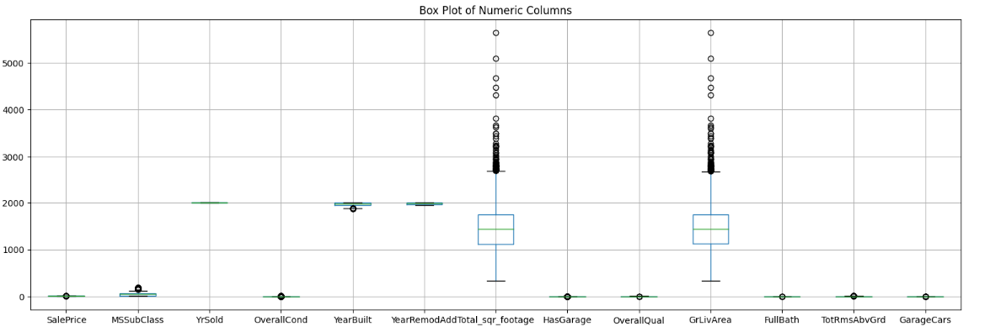
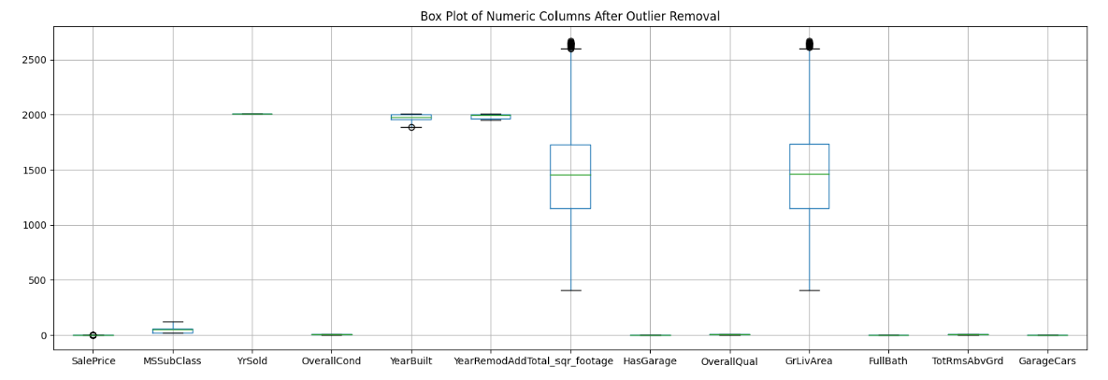
Data Preprocessing
Additionally, identifying and addressing outliers is important to prevent them from adversely affecting the performance of regression models. These steps contribute to the reliability and effectiveness of regression analysis.

Slide 12
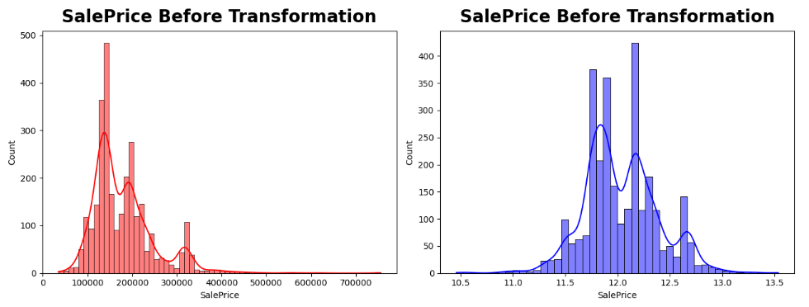
Data Preprocessing
Log transformation is often employed in data preprocessing for regression analysis to address skewness and stabilize variance, especially when dealing with variables that exhibit non-normal distributions.

Slide 13
Feature Engineering
We Created a New Feature “Square Footage“ by adding all these square footage value:
1stFlrSF: First Floor square feet.
2ndFlrSF: Second-floor square feet.
“Total_sqr_footage” indicates the total square footage of the house.
We also Created a New Boolean Feature called “ HasGarage” based on GarageArea.
data["HasGarage"] = (data["GarageArea"] !=0).astype(int)

Slide 14
Model building
Since we already know what to predict (Sales price), we build our model using a supervised learning technique.
As our goal is to predict the price of the house, which is a quantitative variable, we chose Linear regression, Random Forest, and Gradient Boosting Regression Algorithm.
We will evaluate all the models and propose the best one to be used.

Slide 15
Model training
Segregating Features and Labels For Model Training
Splitting Data For Model Training & Testing.
Train Model using Different Regression Algorithms.

Slide 16
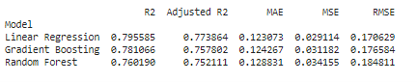
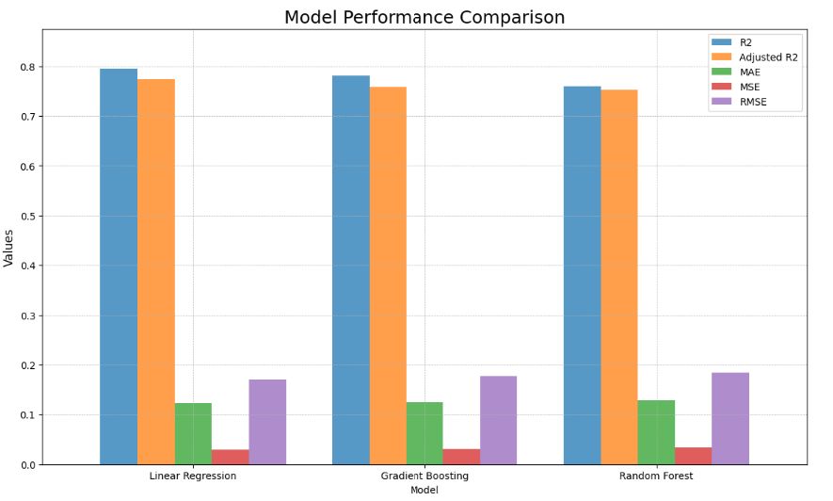
Model evaluation
We analyze the model performance using the following metrics.
Based on the bar graph, Linear Regression appears to be the best model because it has the highest R-squared and Adjusted R2 values, indicating it explains the variance in the data better than the other models. Moreover, it has the lowest Mean Squared Error (MSE) and Root Mean Squared Error (RMSE), suggesting its predictions are closer to the actual values with less deviation. The Mean Absolute Error (MAE) is also the lowest for Linear Regression, further confirming its superior predictive accuracy.

Slide 17
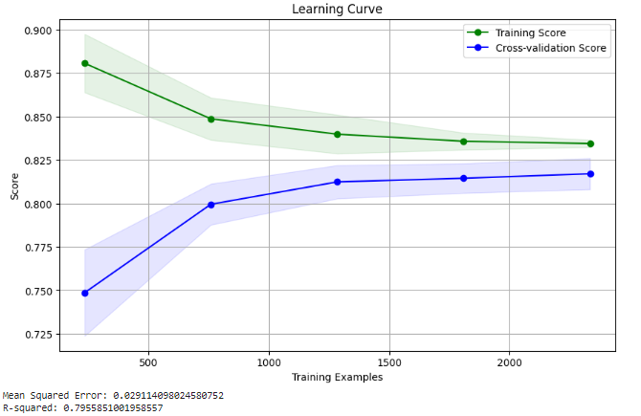
Model Evaluation
The learning curve displays a convergence of training and cross-validation scores as the number of training examples increases, indicating a well-generalizing model.
The model achieves an R-squared value of approximately 79.55 %, indicating a strong fit to the data.
The Mean Squared Error (MSE) is roughly 0.029, which suggests the model predictions are close to the actual values

Slide 18
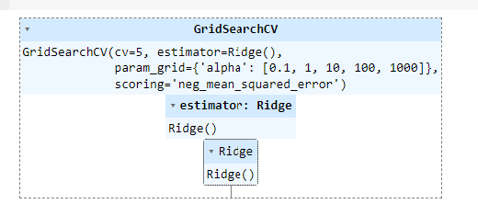
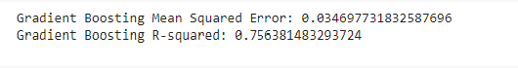
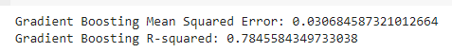
Hyper-Parameter Tunning
To Optimize our model, we employed Grid Search Cross-Validation or linear regression and fine-tuned the regularization strength.
The Gradient Boosting Regressor's complexity was refined by adjusting parameters like the learning rate and tree-specific settings.
This rigorous hyperparameter tuning ensured our models' performance was thoroughly vetted for the best outcomes.

Slide 19
Conclusion
In this project, we developed a house price prediction model with strong performance metrics.
Features like `1stFlrSF`, `GrLivArea`, and `GarageArea` are having strong relation with the target variable.
The best performing model is Linear Regression with highest R2 of 79.5 % & Adjusted_R2 Scores and lowest MAE,MSE,RMSE values.
The project effectively addresses the task of house price prediction and contributes as a valuable tool in the dynamic real estate industry.

Slide 20


